Slide 1


Day 4
QA Architect- Shrish Tripathi

Slide 2
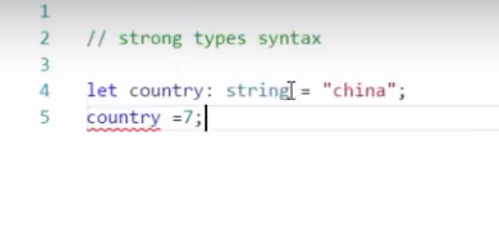
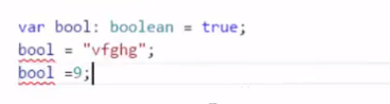
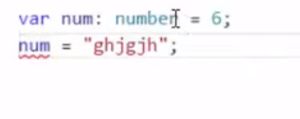
Strong Typing

Slide 3
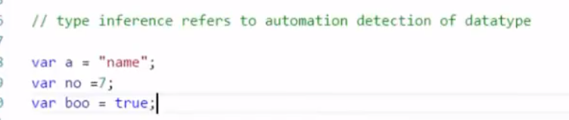
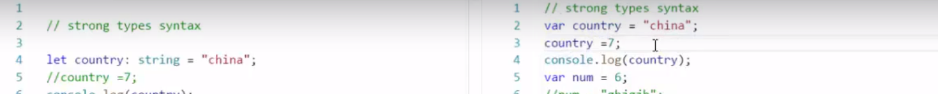
Type inference

Slide 4
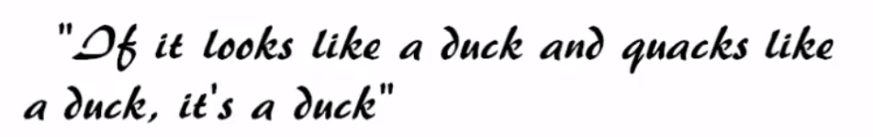
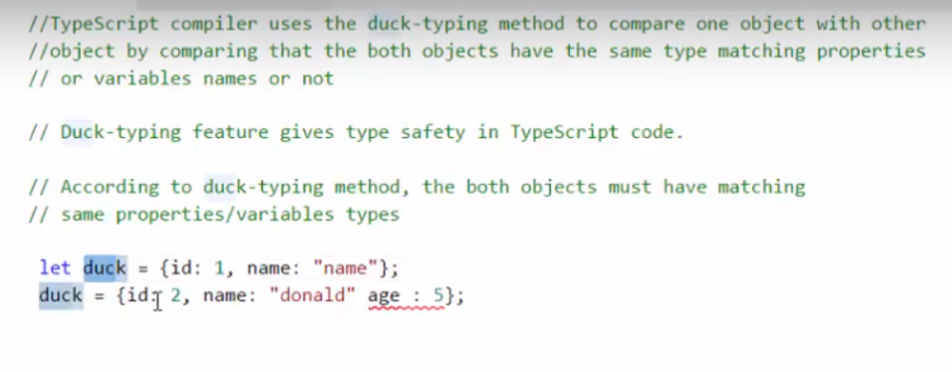
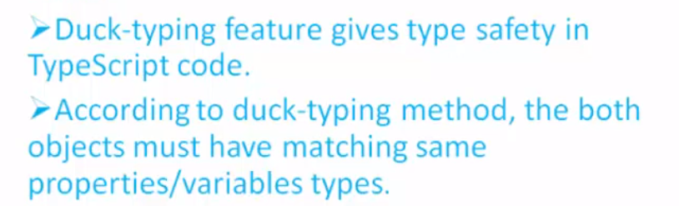
Duck Typing

Slide 5
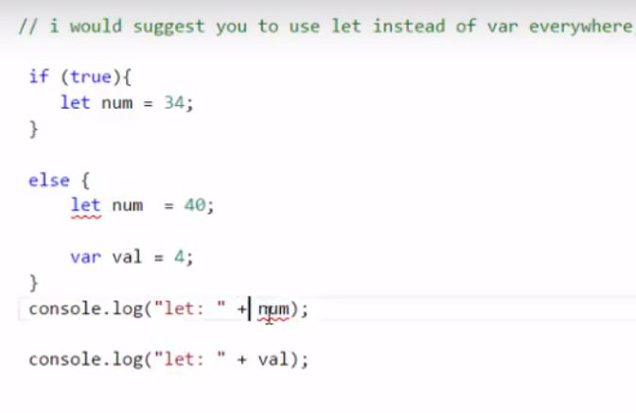

Let and var

Slide 6
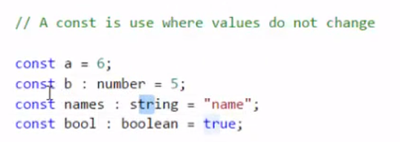
const

Slide 7
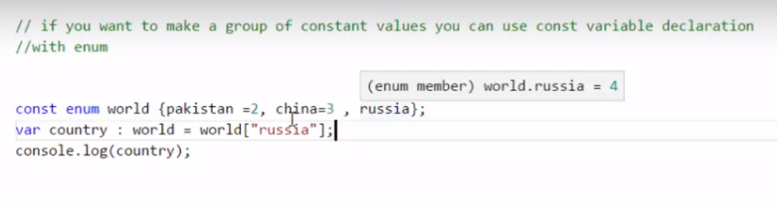
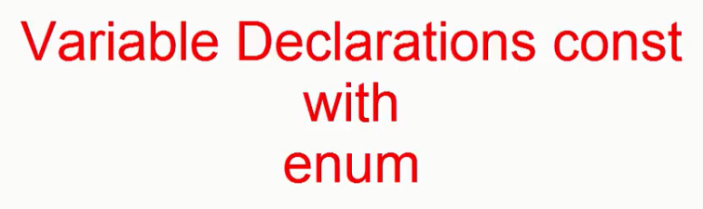

Slide 8

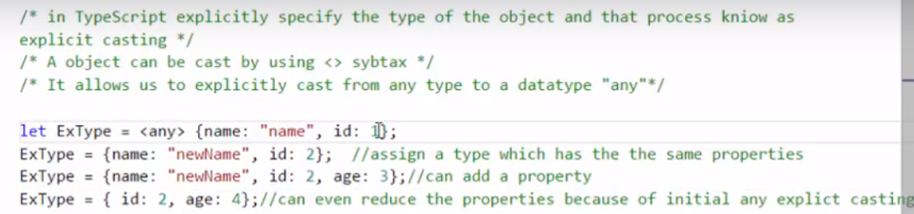

Slide 9
Function

Slide 10
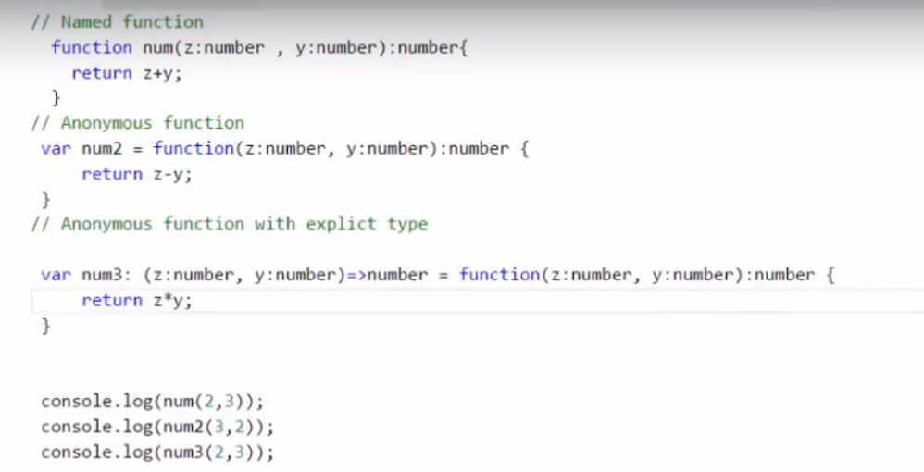


Slide 11
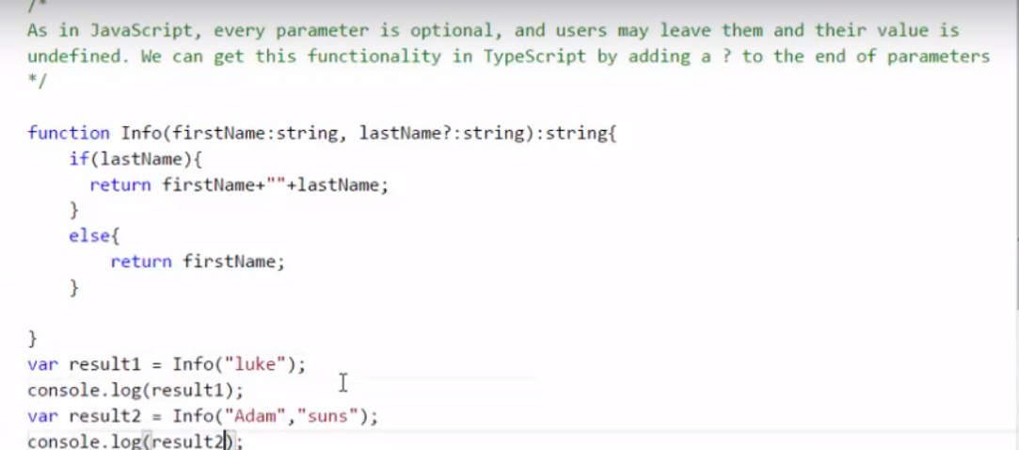
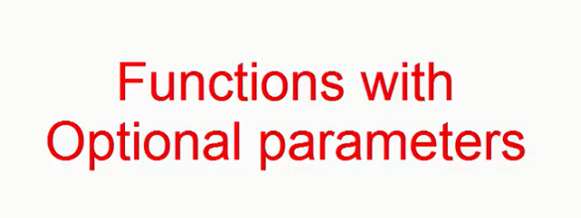

Slide 12
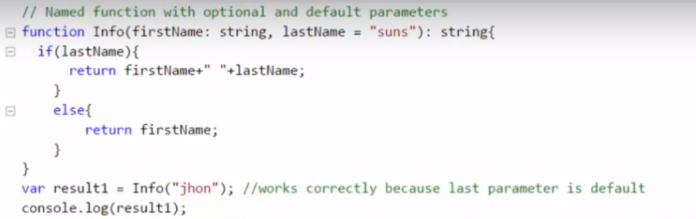
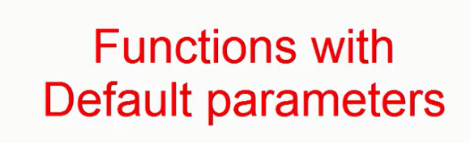

Slide 13
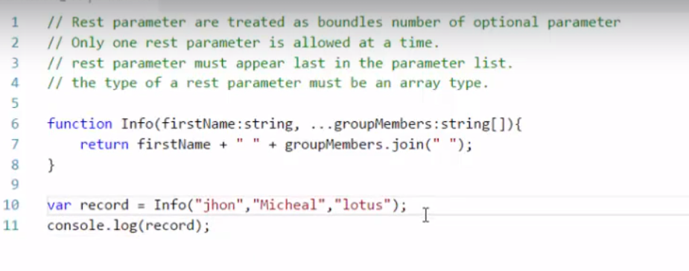
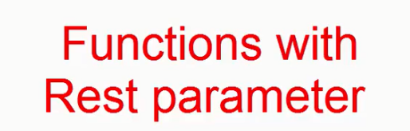

Slide 14
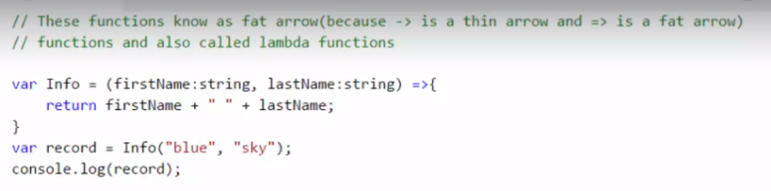
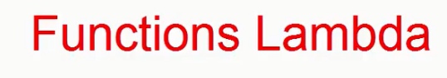
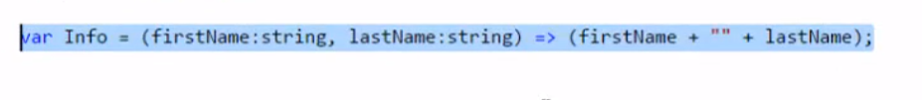

Slide 15
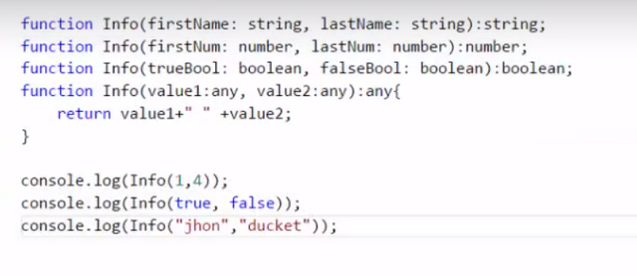


Slide 16
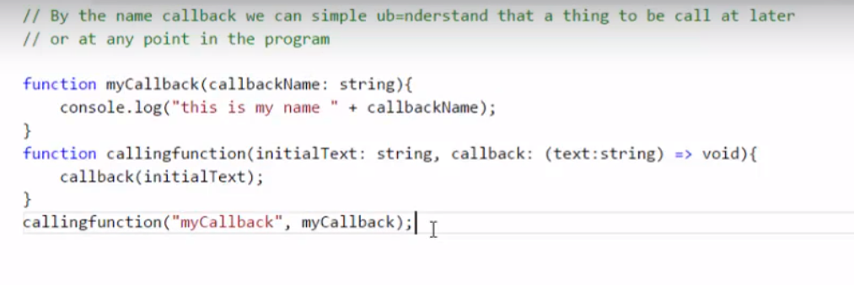


Slide 17
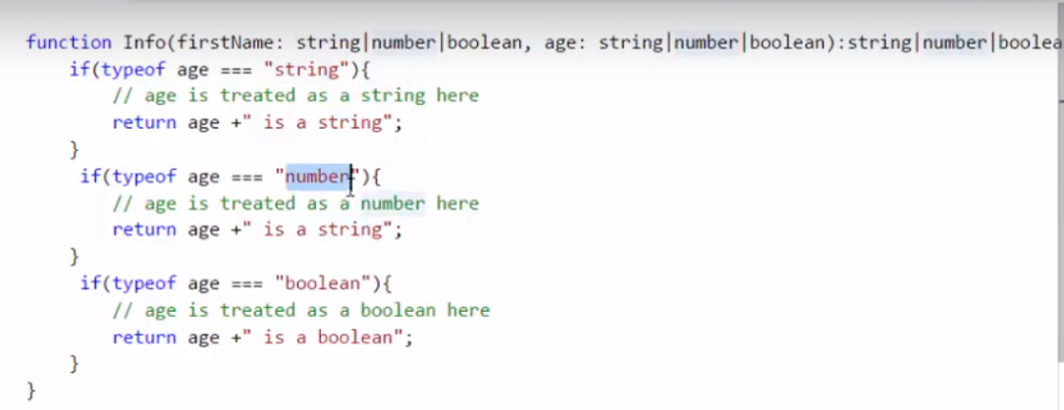

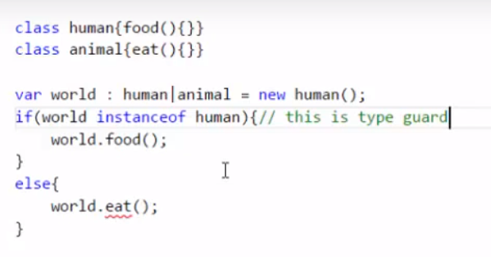

Slide 18
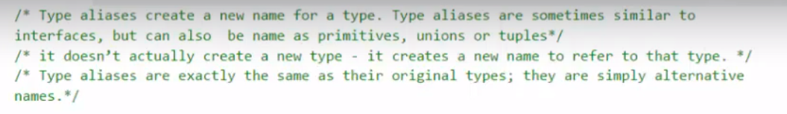
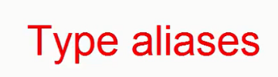
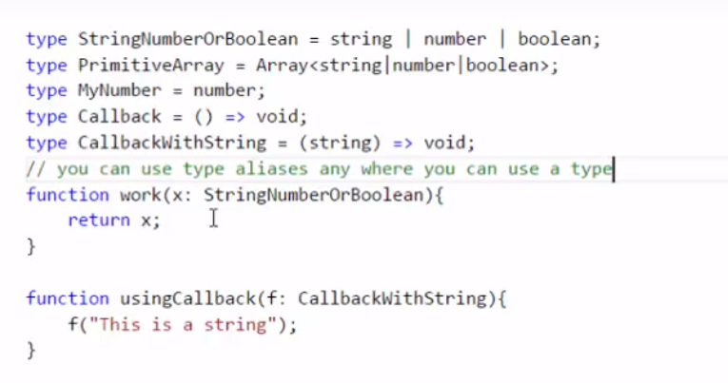

Slide 19
OOPS

Slide 20
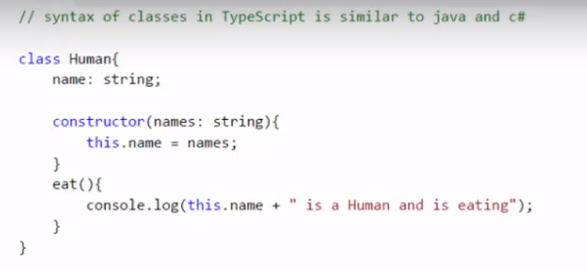
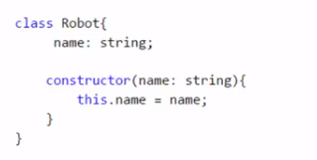

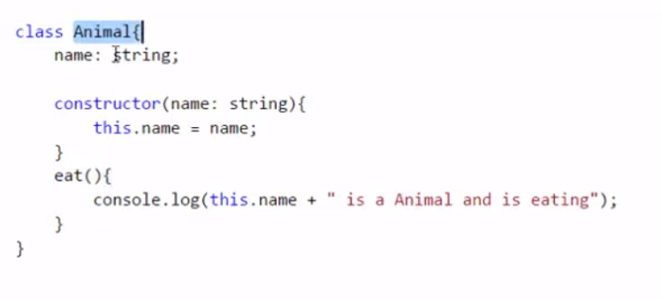
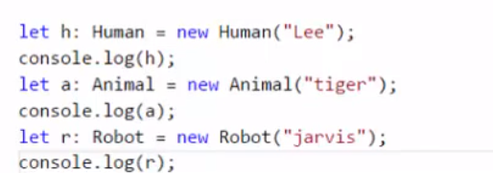

Slide 21
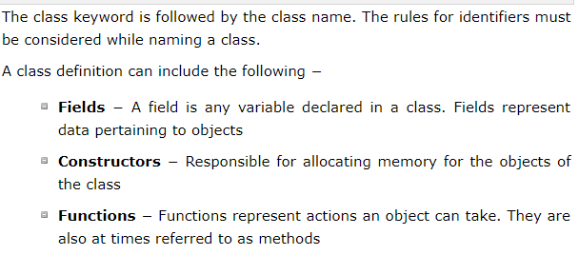
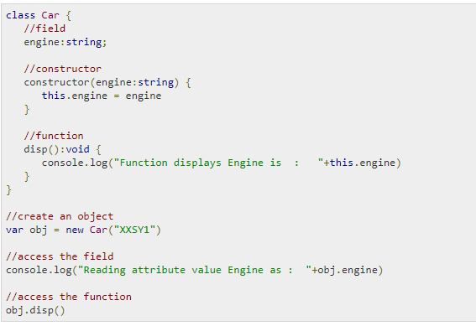

Slide 22
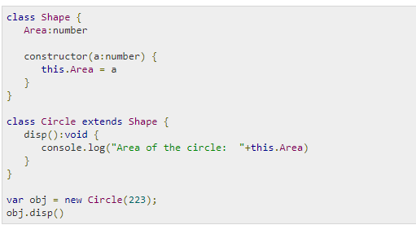

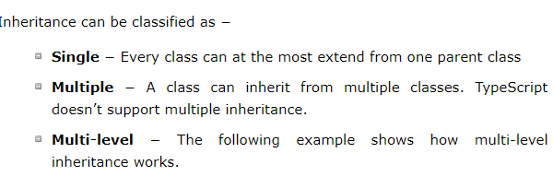

Slide 23
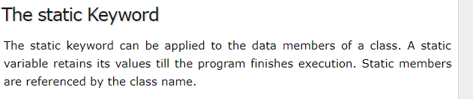
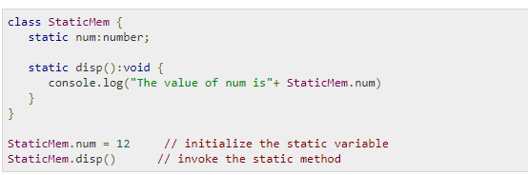
Static keyword

Slide 24
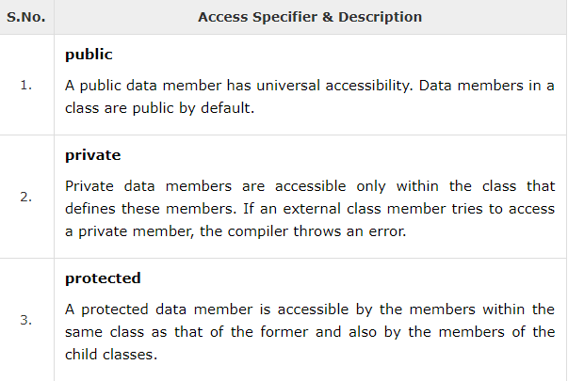
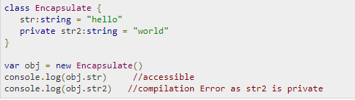
Data Hiding

Slide 25
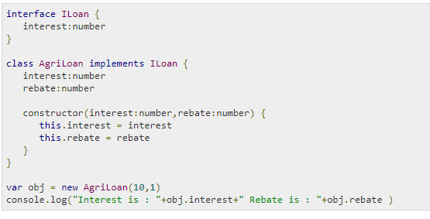
Classes and Interfaces

Slide 26
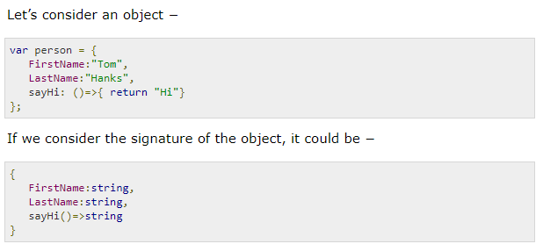
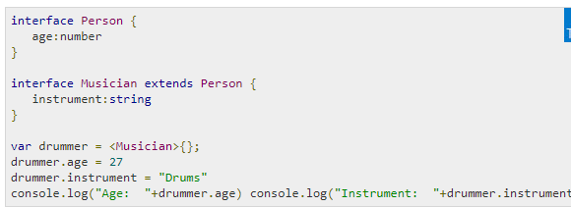
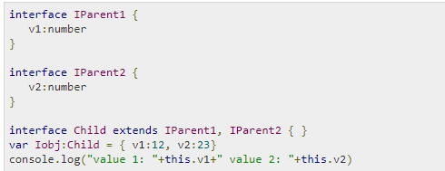
Interfaces

Slide 27
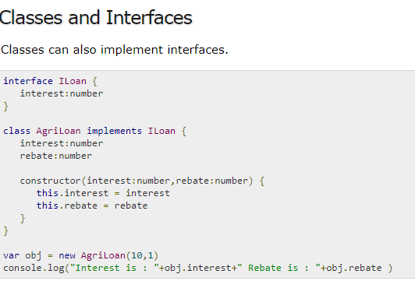

Slide 28
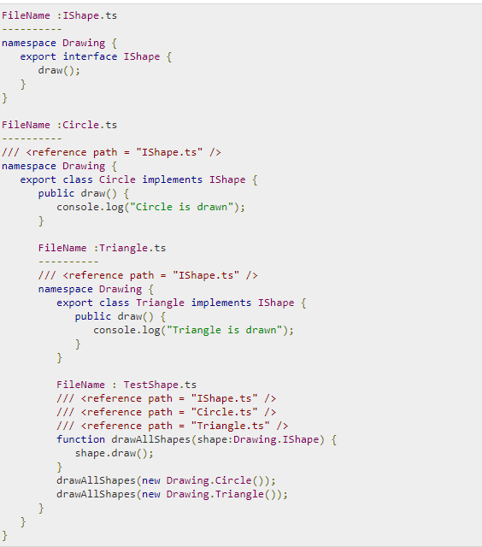
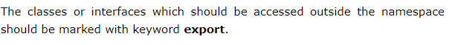
Namespace

Slide 29
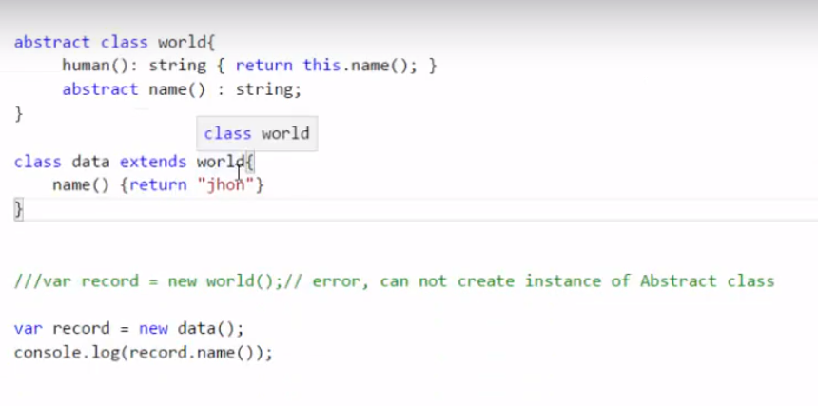



Slide 30


String

Slide 31








Slide 32

Module and export

Slide 33
QUIZ

Slide 34
How Do You Implement Inheritance in TypeScript?
Using temp keyword
Using implement keyword
Using extend keyword
All of the above

Slide 35
What is the Default Access Modifier for Members of a Class in TypeScript
Private
Public
Protected
All of the above

Slide 36

Is that TypeScript code valid? Explain why.

Slide 37

Explain how and why we could use property decorators in TS?

Slide 38

Code snippet ( Blue encircled)- What are we doing here?
1) Polymorphism
2) import/inherit from outside the project package
3) inherit from inside the project but from another library
4) All of the above

Slide 39

Code Snippet? –What are we traying to achieve here -Red encircle code 1) Object creation for another class 2) Creating variables 3) Creating object for same class 4) None of the above

Slide 40
What class contains?
functions and properties only
Method, Constructor, properties only
Function only
All of the above

Slide 41

Can we access below ActionLibrary class from outside?
1) Yes
2) No

Slide 42
If we will not add in constructor in class then how system behave?
System will throw error
System will run without Constructor
System will add constructor in class by default

Slide 43
How Can You Allow Classes Defined in a Module to be Accessible Outside of the Module?
Outside the module, you can’t access class
We can access out side the module
Using Public , we can access classes outside the module

Slide 44
Does TypeScript Support All Object Oriented Principles?
Yes
NO
Partial

Slide 45

Identify the keywords?
Class
Function
Function

Slide 46
Which statement is correct for “Modules” TypeScript?
Its contain Classes
Its contain classes and interfaces
Its contain only interfaces
Modular is similar as C# -namespace concept

Slide 47

If below encircled component want to access each other based on functionality then How they can achieve this?
Using Import and export Keyword
Using Inheritance concept
Using only import keyword
All of the above

Slide 48
Q25. What are the Disadvantages of TypeScript?
TypeScript is just another way to write JavaScript. It doesn’t fix the problems of JavaScript. It just creates an illusion that it does.
One more tool to learn.
TypeScript has dependency on type definition files, if you wish to use any existing JavaScript libraries.
Quality of type definition files is a concern as how can you be sure the definitions are correct?
Frequent releases of new versions JavaScript library is also a pain area. Because if their type definition files are not updated then you can’t use them instantly.
In order to run the application in the browser, a compile step is required to transform TypeScript into JavaScript.
Web developers are using JavaScript from decades and TypeScript doesn’t bring anything new.
To use any third party library, definition file is you need. And not all the third party library have definition file available.

Slide 50


Slide 51


Slide 52


Slide 53


Slide 54


Slide 55


Slide 56


Slide 57


Slide 58


Slide 59


Slide 60


Slide 61


Slide 62


